Slide 1

Our Project Initially : Confusion

Slide 2

Intense Research

Slide 3

Trial and Error

Slide 4
Loop

Slide 5

Loop
Slow

Slide 6
Why ?
Let us see with an
Example

Slide 7
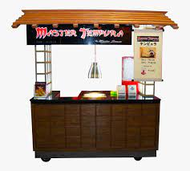
Why ?
Project: To cook Traditional Food

Slide 8
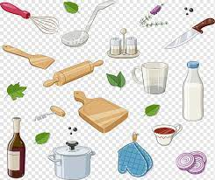
Why ?
Many Ingredients
Project: To cook Traditional Food

Slide 9
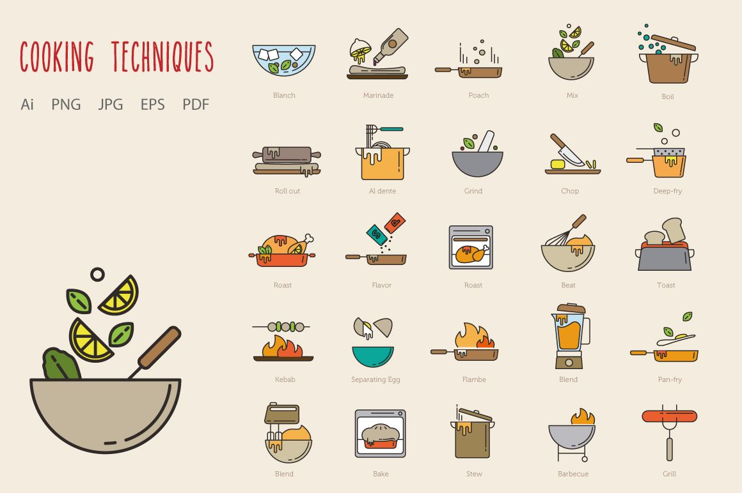
Why ?
Many Techniques
Many Ingredients
Project: To cook Traditional Food

Slide 10
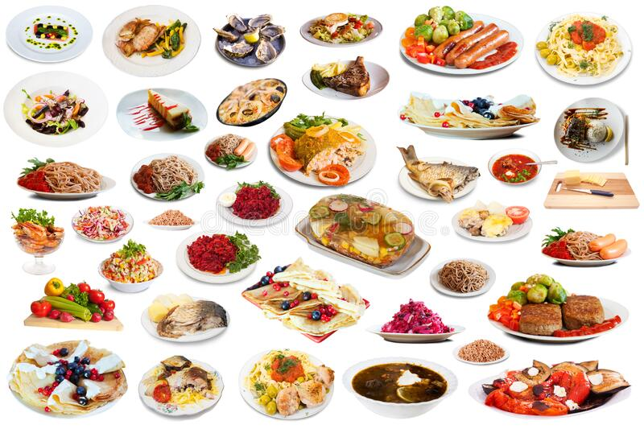
Why ?
Many Techniques
Many Ingredients
And many Dishes
Project: To cook Traditional Food

Slide 11
Why ?
Many Processes
Analogy
Many Libraries
And Many Outputs
Project: To cook Traditional Food

Slide 12


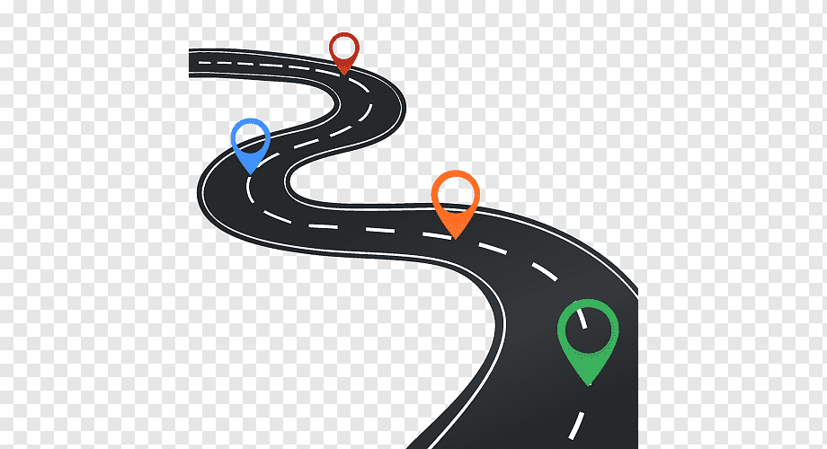
Why ?
Project: To cook Traditional Food
The First Attempt
Beginners with no experience
So less effective leadership
So no roadmap

Slide 13

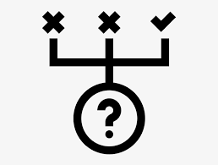
Why ?
Project: To cook Traditional Food
The First Attempt
Beginners with no experience
So less effective leadership
So no roadmap
Thus Trial and Error

Slide 14
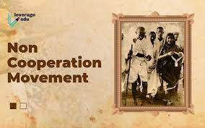
Why ?
Project: To cook Traditional Food
The First Attempt
Beginners with no experience
So less effective leadership
So no roadmap
Thus Trial and Error

Slide 15

Why ?
Project: To cook Traditional Food
The First Attempt
Beginners with no experience
So less effective leadership
So no roadmap
Thus Trial and Error

Slide 16
Why ?
Project: To cook Traditional Food
The First Attempt
Beginners with no experience
So less effective leadership
So no roadmap
Thus Trial and Error

Slide 17
Why ?
Project: To cook Traditional Food
The First Attempt
Beginners with no experience
So less effective leadership
So no roadmap
Thus Trial and Error

Slide 18
Why ?
Project: To cook Traditional Food
The First Attempt
Beginners with no experience
So less effective leadership
So no roadmap
Thus Trial and Error

Slide 19
But, …
Making a project is always a team work
We need individuals with speacial abilities
We need few people with leadership abilities
The Project needs both.

Slide 20
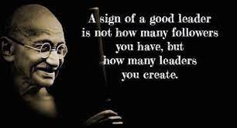

Slide 21
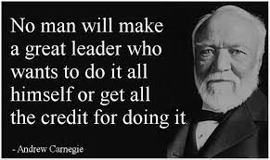

Slide 22
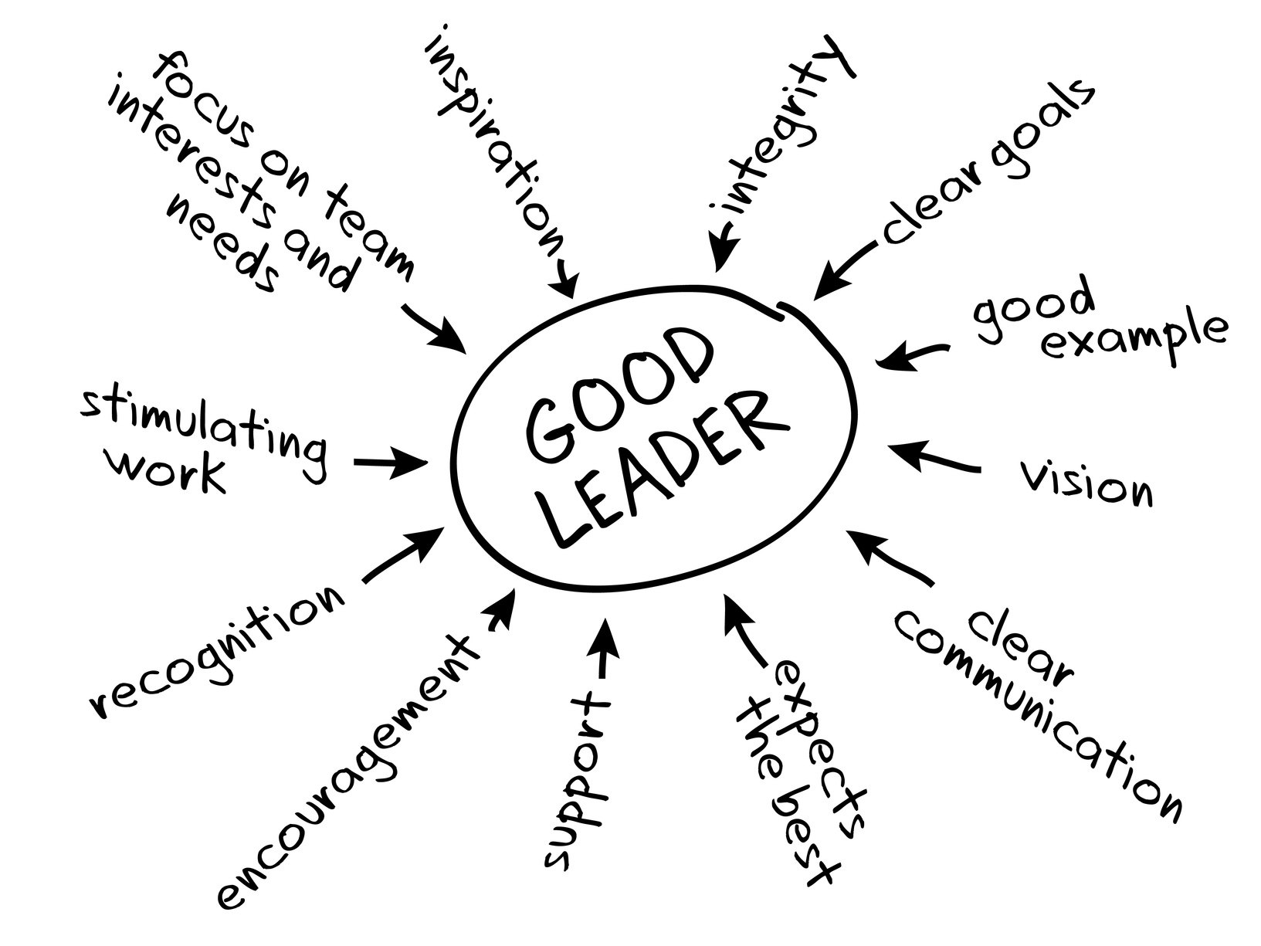

Slide 23
Now: ROADMAP and OBJECTIVES

